Slide 1
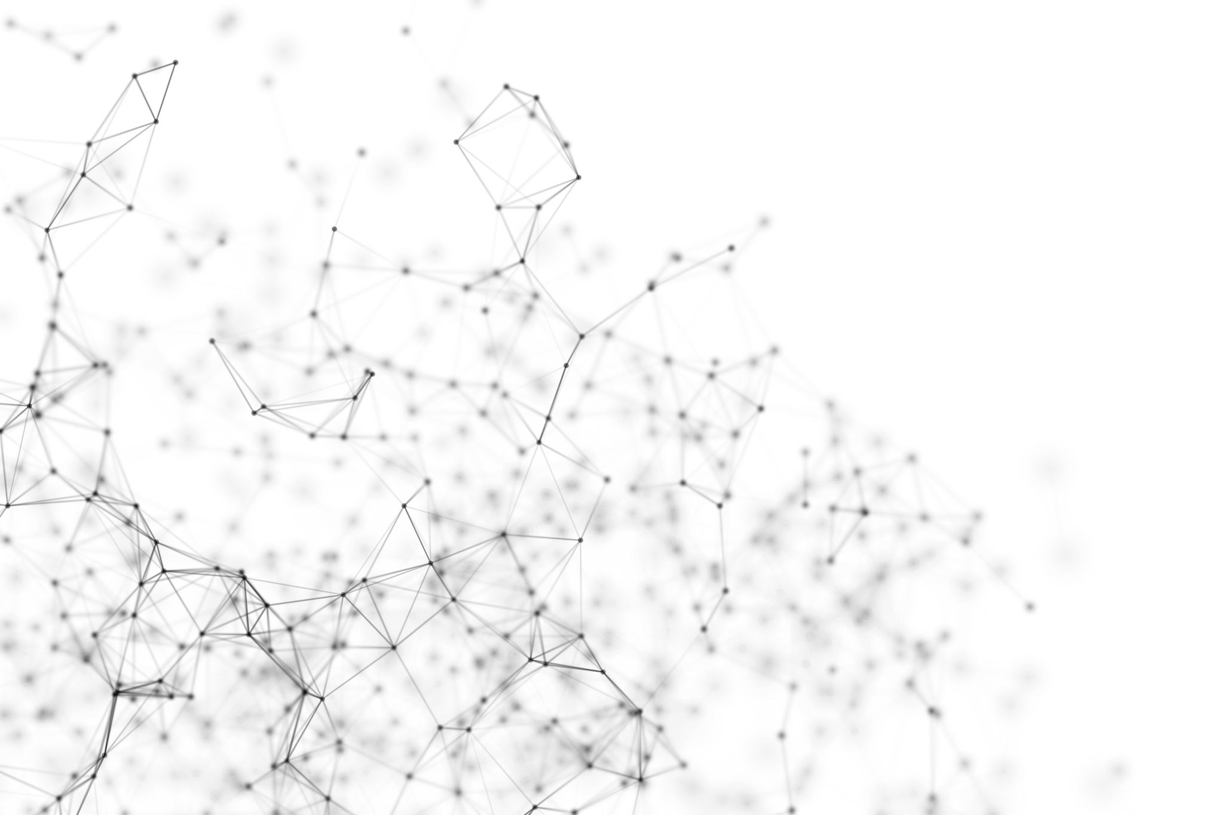

Machine learning in EEG microstate analysis: new hope for personalising treatment of mood disorders.
Krzysztof Pietruczuk ¹ , Szymon Bierzanowski ²
¹ Division of Biostatistics and Neural Networks, Medical University of Gdańsk
² Faculty of Applied Physics and Mathematics, Gdańsk University of Technology

Slide 2





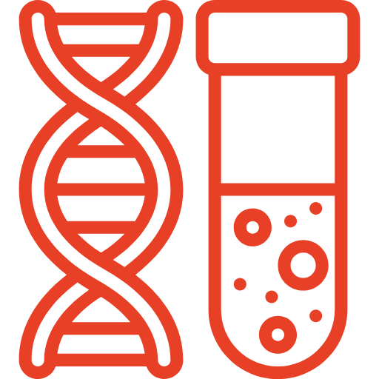
Machine learning in EEG microstate analysis: new hope for personalising treatment of mood disorders.
Depression
is a huge problem all over the world.
300 000 000 people around the world suffer from depression
Every year 700 000 people take their own lives due to depression
This is both
a health and economic problem.
Increase in depression cases is also a consequence of the Covid-19 pandemic
challenges of modern psychiatry
Drug resistance. Difficulty in selecting pharmacotherapy.
Long waiting time for treatment results.
Increased risk of suicidal behavior in the first weeks of treatment.
Lack of objective biomarkers for clinical decision-making and monitoring patient response.

Slide 3
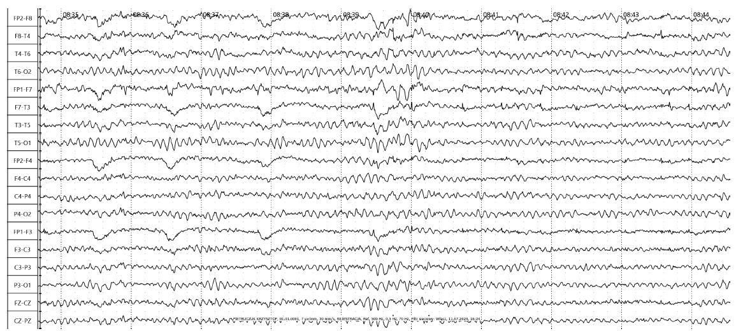
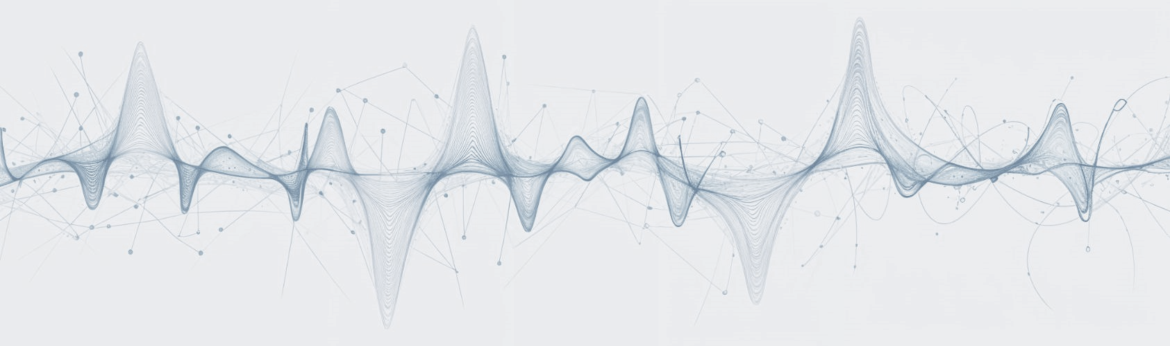
Machine learning in EEG microstate analysis: new hope for personalising treatment of mood disorders.
Can an EEG study be a solution?
What is it and what does it involve?
A non-invasive method to study the electrical activity of the brain
Recording changes in electrical potentials produced by neurons.

Slide 4
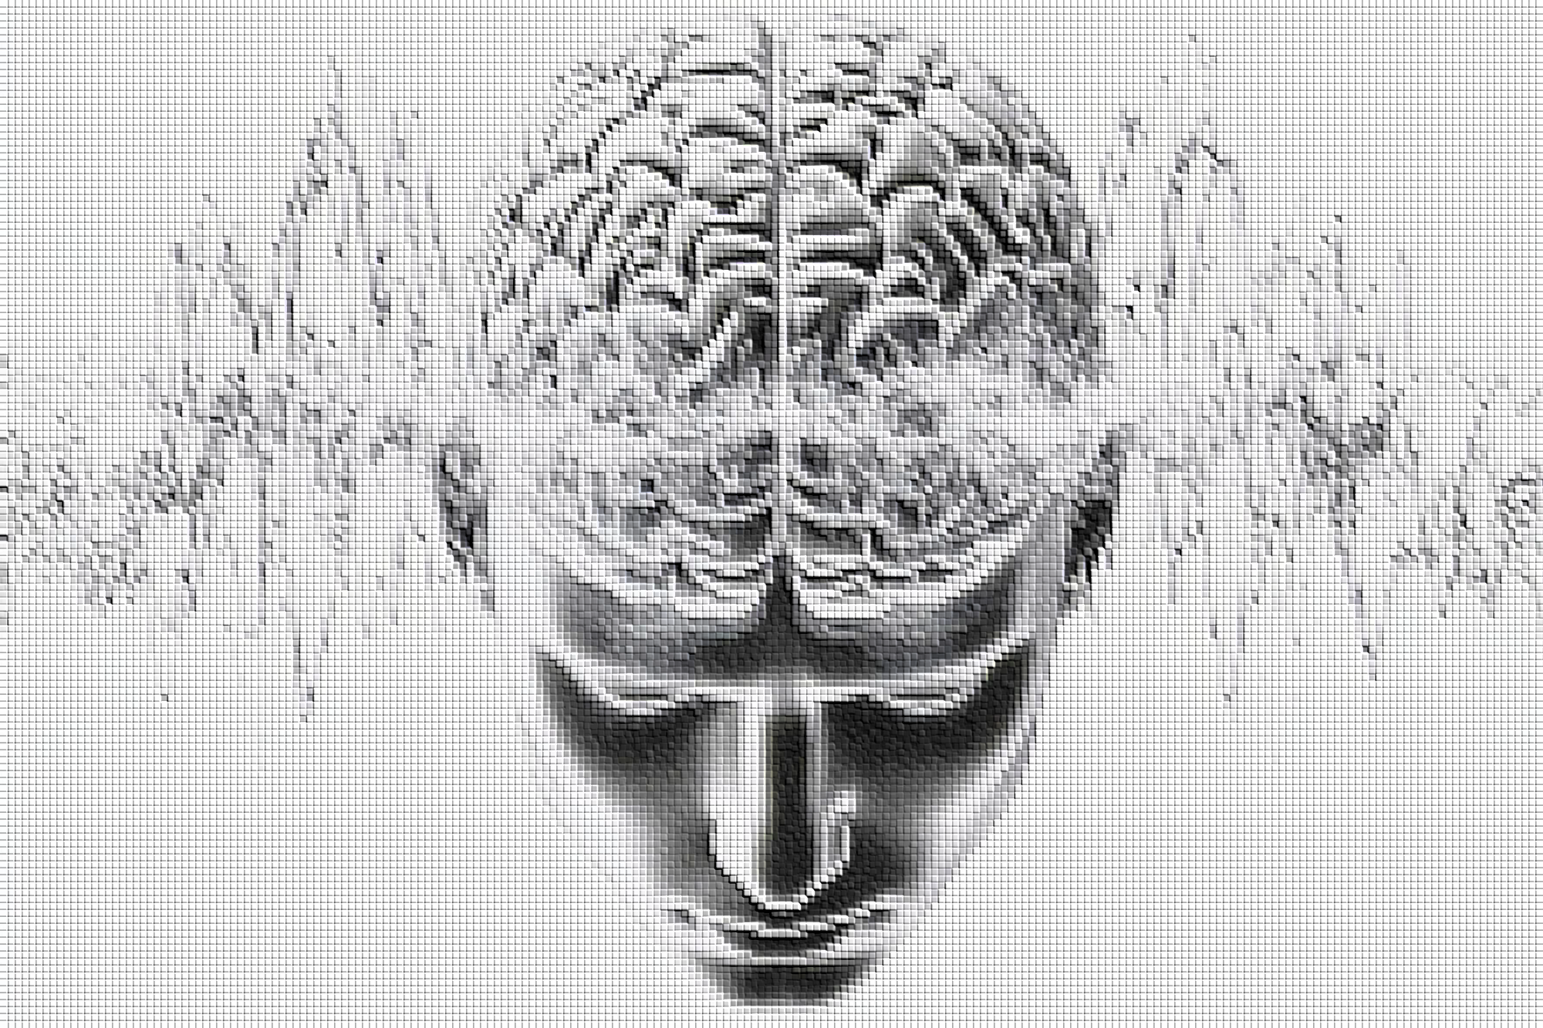
Machine learning in EEG microstate analysis: new hope for personalising treatment of mood disorders.
Application of the EEG test
Diagnosis and monitoring of epilepsy
Study of sleep disorders
Assessment of states of consciousness

Slide 5

Machine learning in EEG microstate analysis: new hope for personalising treatment of mood disorders.
Difficulties in the use of EEG in the treatment of mood disorders
Greater subtlety of change and heterogeneity of disorder

Slide 6
Machine learning in EEG microstate analysis: new hope for personalising treatment of mood disorders.
Can AI help identify useful EEG biomarkers for diagnosing and monitoring treatment of depression?
EEG microstates
patterns of scalp potential maps recorded with the help of EEG that change dynamically over time
'elementary building atoms' of cognitive processing
changes in EEG microstates likely result from brain network disruptions

Slide 7
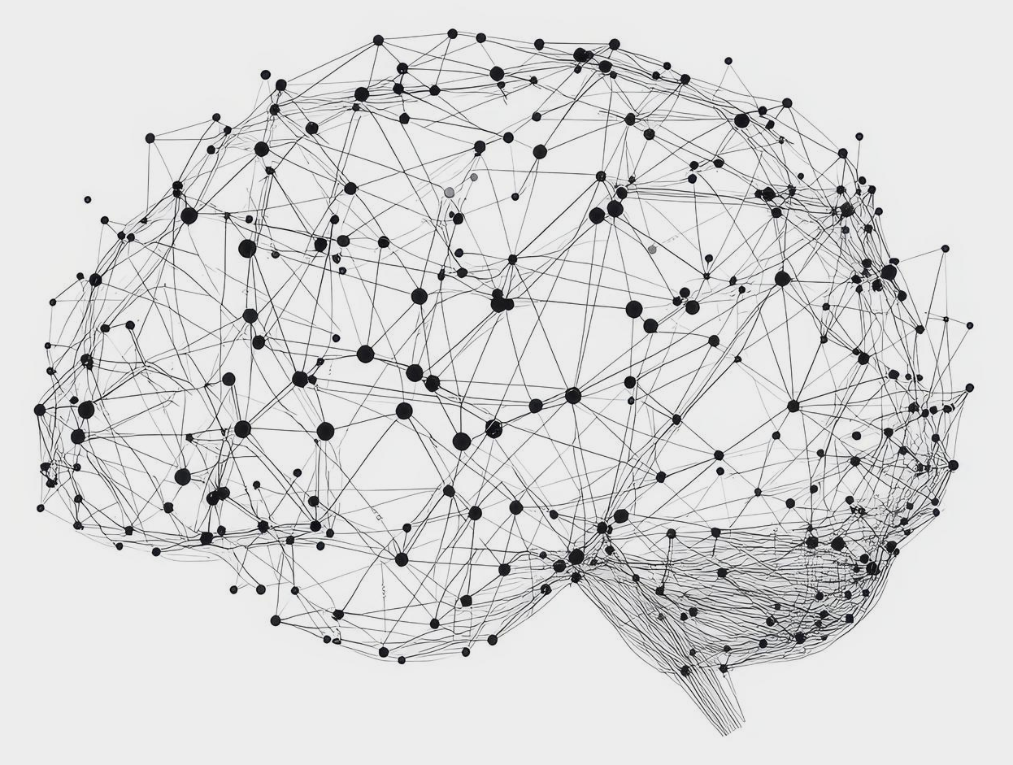
Machine learning in EEG microstate analysis: new hope for personalising treatment of mood disorders.
How the algorithm works:
Preprocessing of EEG data. Artefact correction and normalisation.
Dimensionality reduction using the t-SNE algorithm.
Determination of the stability of the topography at a given point in time.
Calculation of the difference between cluster maps.
Analysis of individual micro-state parameters and visualisation.
Performing clustering with the k-Means algorithm.

Slide 8
Machine learning in EEG microstate analysis: new hope for personalising treatment of mood disorders.
Frequency of occurrence.
Average stability time.
Probability of transitions between individual microstates.
Time coverage factor for the whole waveform.
Average spatial correlation.
Global mean field strength.
Parameters derived from time series analysis of microstates

Slide 9
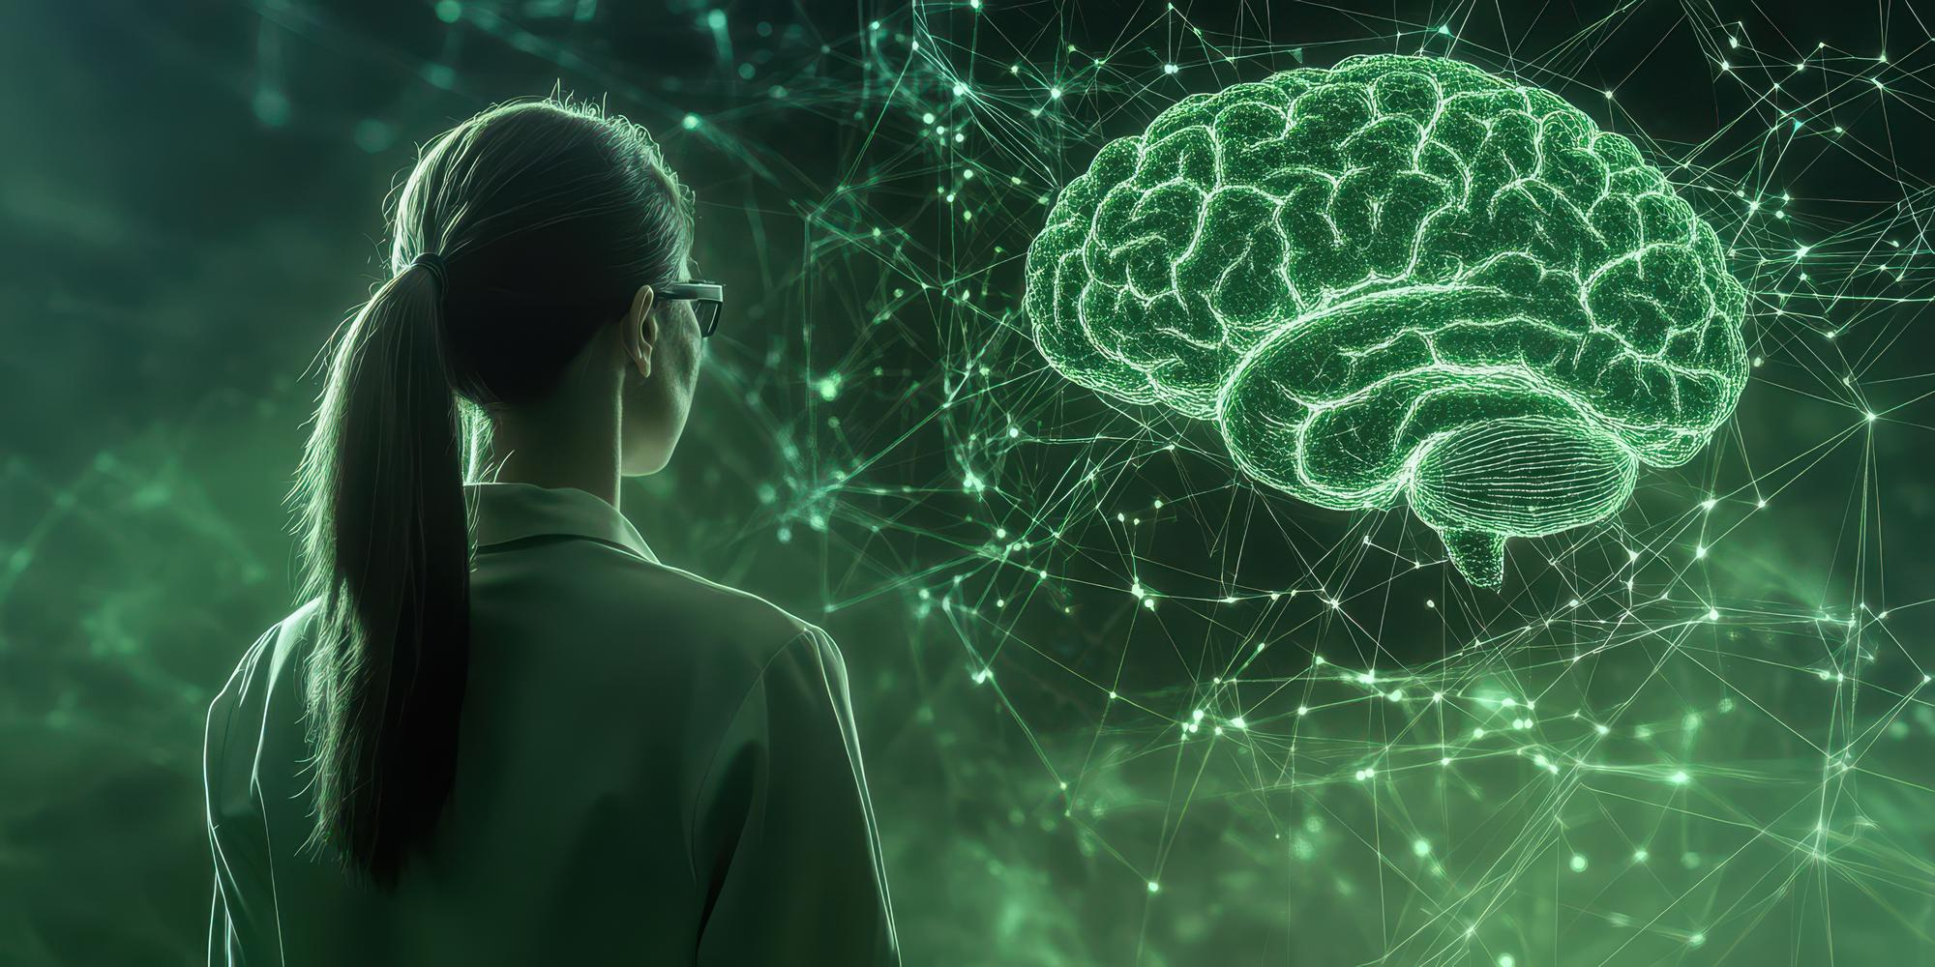
Machine learning in EEG microstate analysis: new hope for personalising treatment of mood disorders.
Current research results
The relationship of microstates to specific mental processes has been demonstrated.
Identification of anatomical locations of microstate sources
Characterisation of potential biomarkers for neuropsychiatric diseases has begun.

Slide 10
Machine learning in EEG microstate analysis: new hope for personalising treatment of mood disorders.
Challenges ahead
development of microstates in the context of diagnosis and monitoring the course of therapy for depression
assess both the optimal choice of the number of clusters
replacing the classic k-means algorithm with other, more advanced clustering techniques
determine the effect of the type of pharmacotherapy used on microstates
carry out the mapping to the structural brain image obtained from the MRI measurement
The creation of a predictive model using machine learning methods will enable the application of effective and personalised treatment.

Slide 11
Machine learning in EEG microstate analysis: new hope for personalising treatment of mood disorders.
Thank you for your attention

